Slide 1



Microsoft 365 Freelance Toolkit Case studies to use for your SharePoint Communication Site

Slide 2
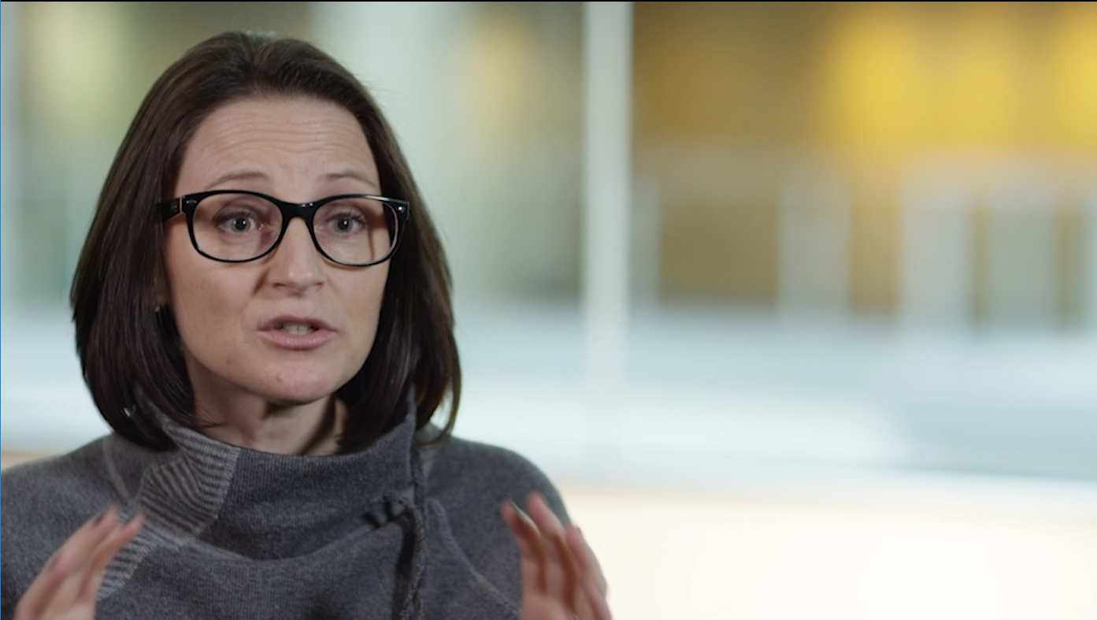
Case Study – Video Production
Project
Deliverable
We recorded a 45-minute interview. The deliverable was provided one
day before the due date.
Feedback to Freelancer
"Got edit before deadline. Thank You!"
Notes:
https://www.upwork.com/jobs/~~eca33bdd8c00e020

Slide 3

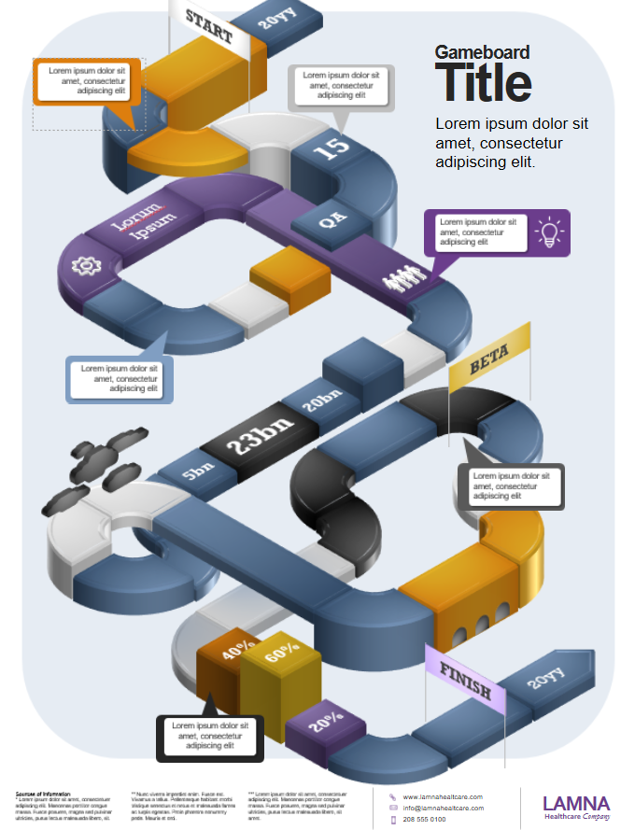
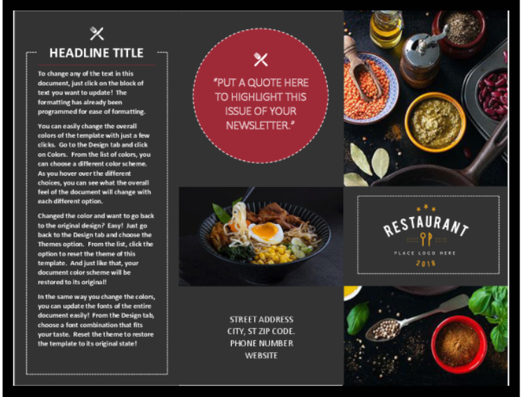
Case Study – Create modern Office templates
Project
Deliverable
Two freelance project leads managed seven freelancers to create 280 new Word, XL, and PPT templates in three months.
Feedback to Freelancers
"We could never have accomplished this in such a short period of time without the depth of freelance talent we were able to harness.”
Notes:
https://www.upwork.com/jobs/~~eca33bdd8c00e020

Slide 4
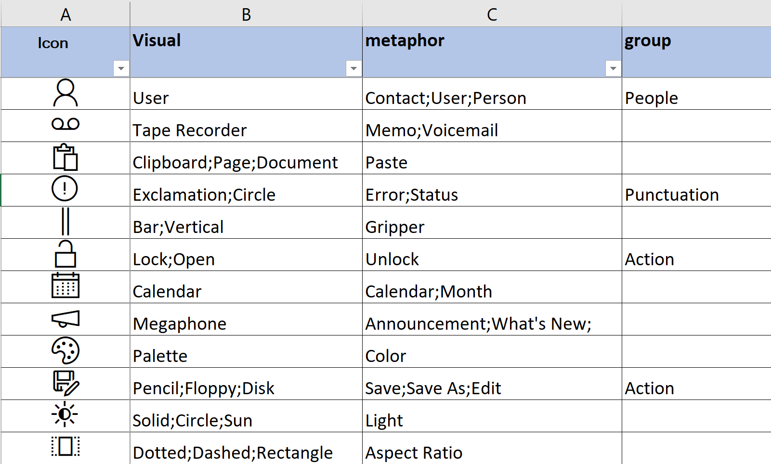
Case Study – Data Science & Analytics
Project
Deliverable
We needed help with keywording our library of icons for an internal database tool. This involved breaking out the visual (physical), conceptual (metaphor), and category (genre) tags for each icon. We have 4,000+ icons that need to be defined and categorized as part of our taxonomy development.
Please insert picture of deliverable here.
Feedback to Freelancer
“Michael was easy to communicate with and asked questions to clarify what we needed to get the job done right. I appreciated the follow-ups and would be happy to work with him again."
Notes:
https://www.upwork.com/jobs/~~eca33bdd8c00e020

Slide 5
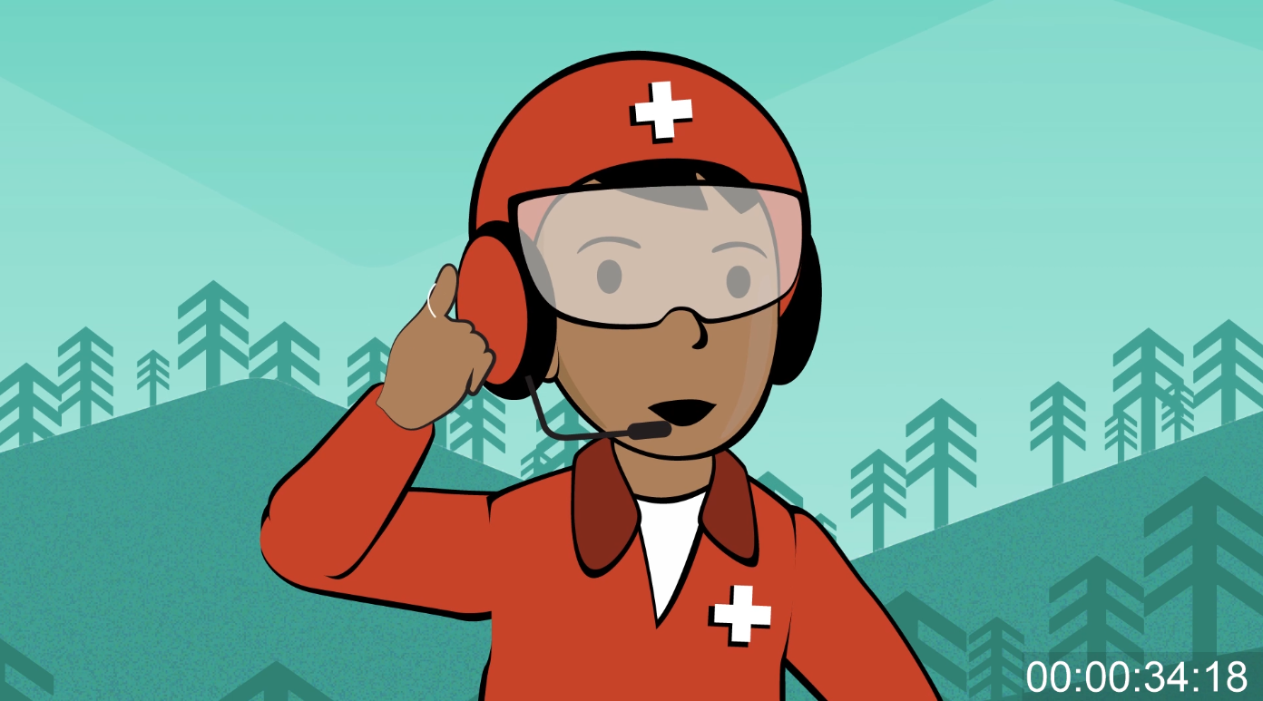
Case Study – Design & Creative / Illustration
Project
Deliverable
Our animator had 4 other videos on his plate, so we decided to
outsource this project. The characters came back on point – it saved
us so much time! We are happy to work with Vicki again!
Please insert picture of deliverable here.
Feedback to Freelancer
“Wonderful working with Vicki, she understood our ask and had a quick turnaround.”
Notes:
https://www.upwork.com/jobs/~~eca33bdd8c00e020

Slide 6
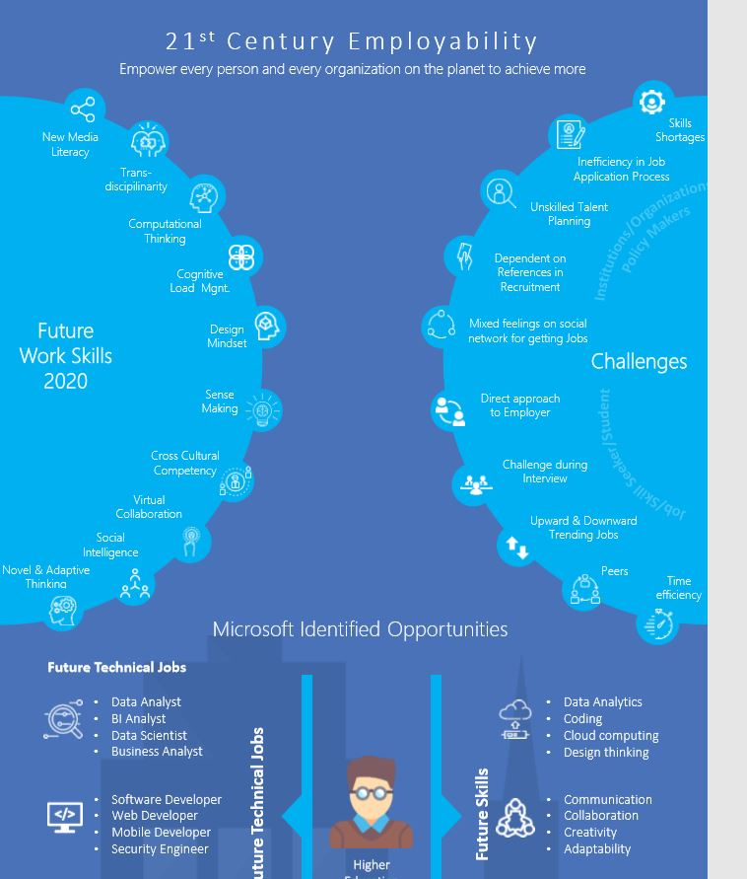
Case Study –Design infographic using a small business ppt deck as source material
Project
Deliverable
Review a strategy deck and create an example infographic to
summarize the information as a different way to share the future
employability challenges and opportunities.
Feedback to Freelancer
"Great work!" I've used Rajdeep on many projects and his work is always very quick (2-4 days) and super helpful to our busy team. Much of the other work has been research oriented; sometimes with graphical summaries.
Notes:
https://www.upwork.com/jobs/~~eca33bdd8c00e020

Slide 7
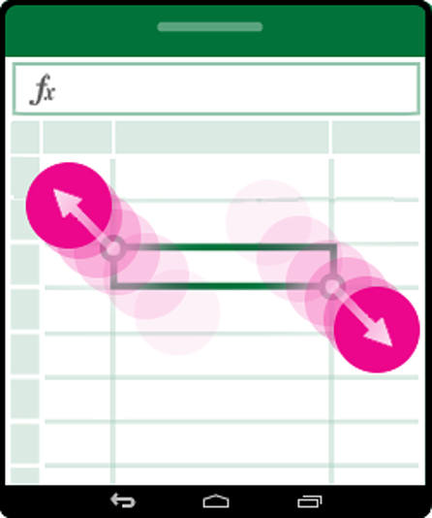
Case Study – Graphic Design - 3 generic screenshots for Excel Android Touch Guide
We needed to update an existing guide with additional screenshots of new functionality. They needed to show touch gestures and match the styles of existing art.
Project
Deliverable
Feedback to Freelancer
"Thanks Jonathan. Appreciate the quick responses and iterations so we get what we need."
Notes:
https://www.upwork.com/jobs/~~eca33bdd8c00e020

Slide 8
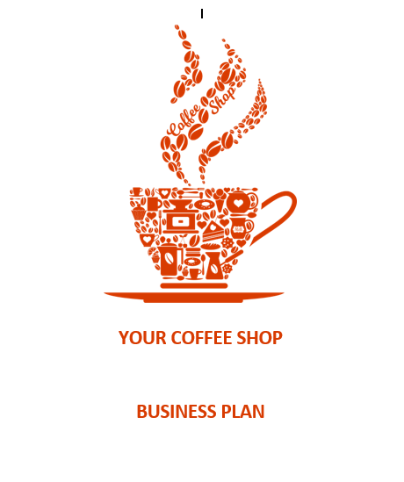
Case Study – Small Business expert to consult on starting up a small business template
Project
Deliverable
Create content for a set of 6 small business templates, including a sample business plan. A pitch deck, and start up checklist. This required expertise beyond what we had on our team and we were able to find several small business experts.
Feedback to Freelancer
“Work was done promptly and as requested.”
Notes:
https://www.upwork.com/jobs/~~eca33bdd8c00e020

Slide 9
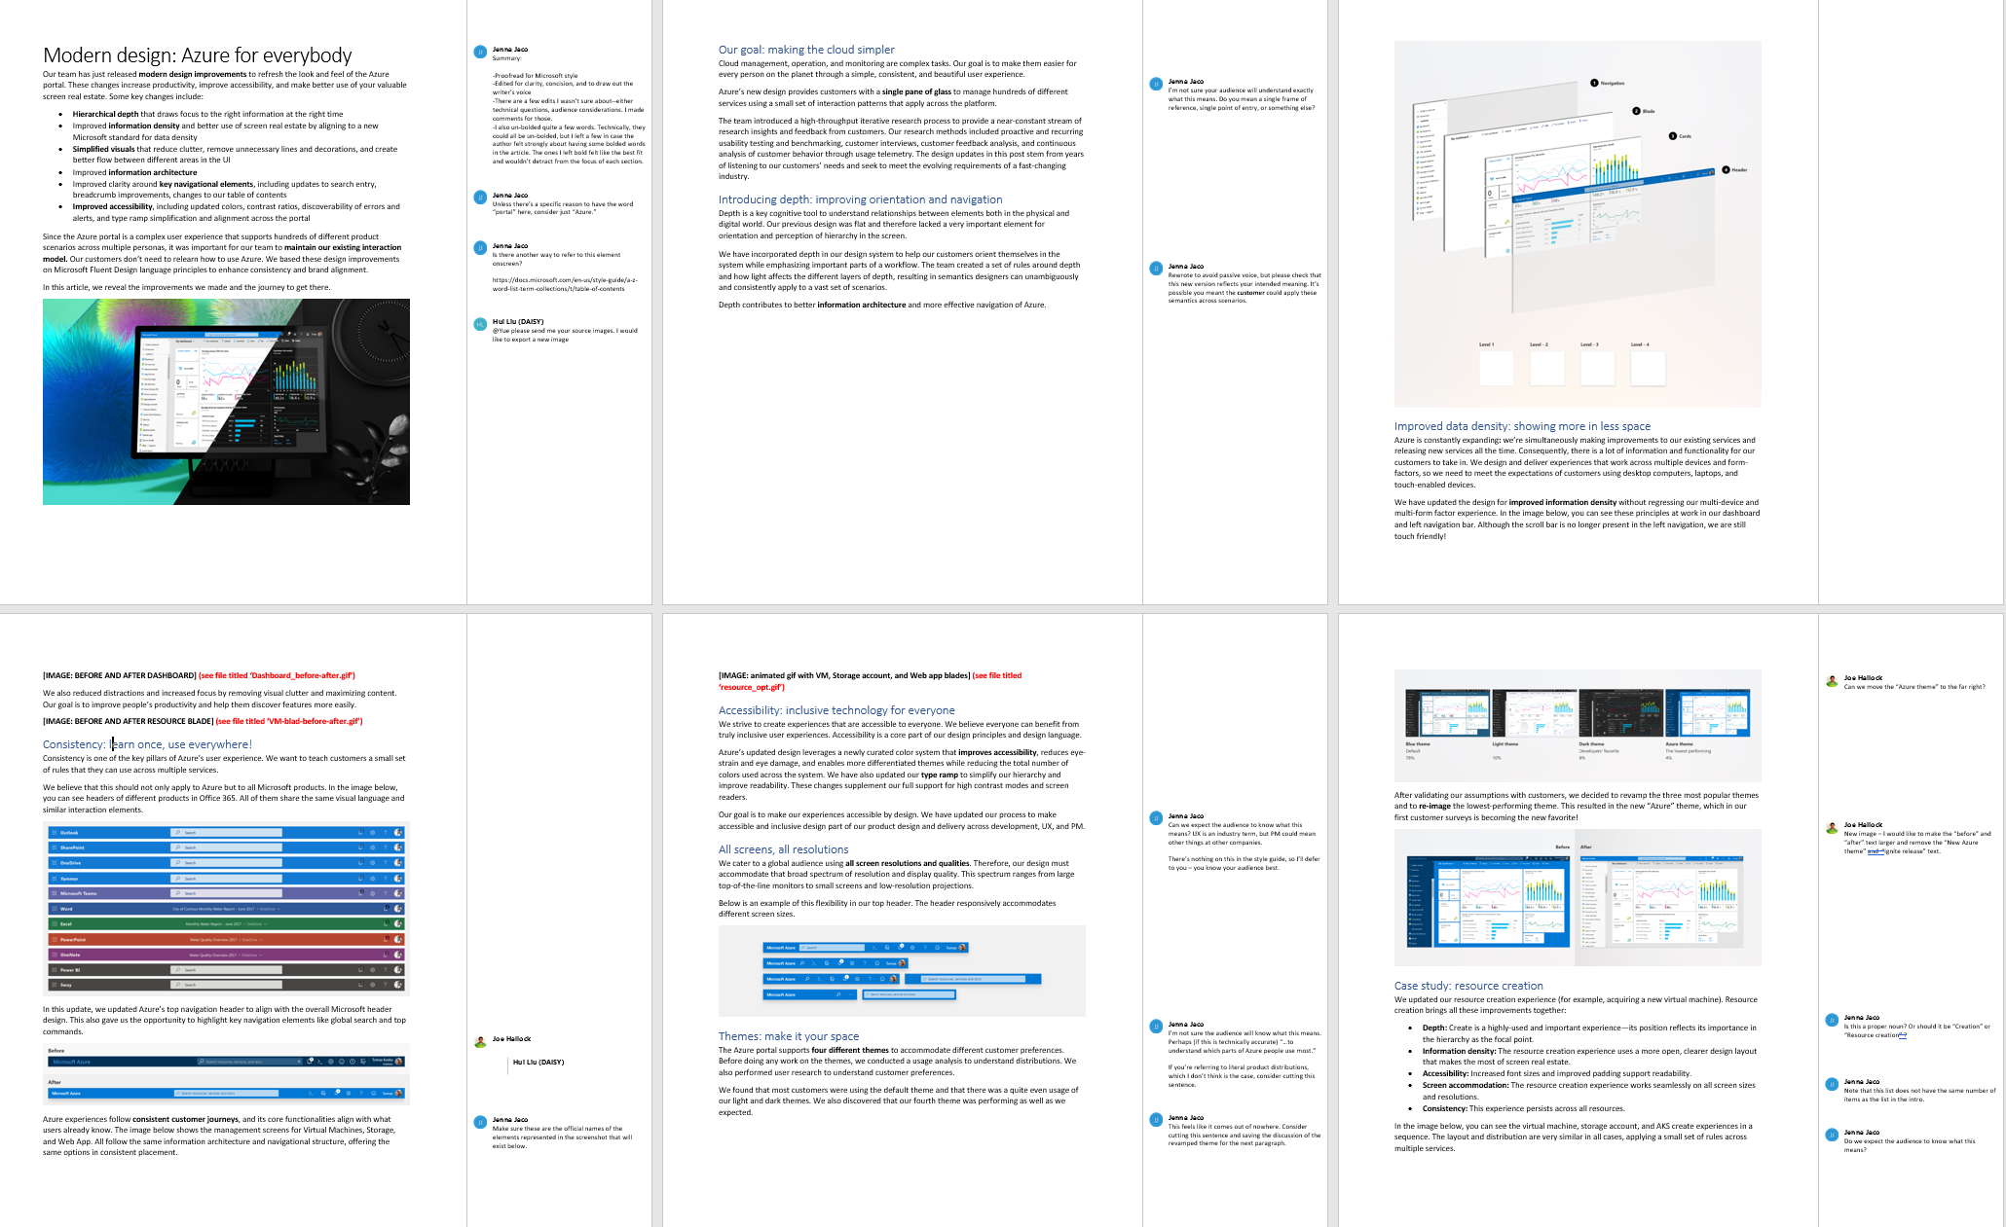
Case Study – Writing
Project
Deliverable
Two articles needed to be edited and proofed for clarity and concision, and needed to be balanced by the MSFT Style Guide and the author's voice.
Feedback to Freelancer
“Jenna was able to accommodate a very quick turnaround time for this last-
minute project.”
Notes:
https://www.upwork.com/jobs/~~eca33bdd8c00e020

Slide 10

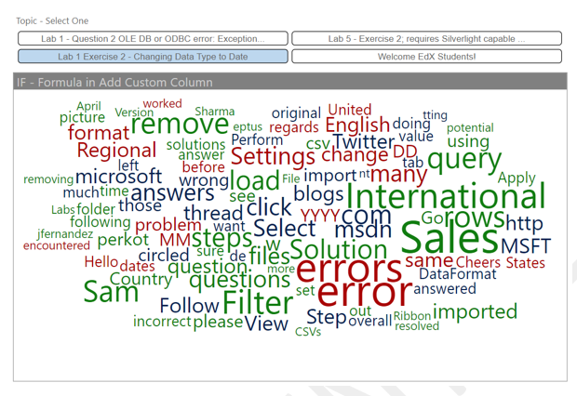
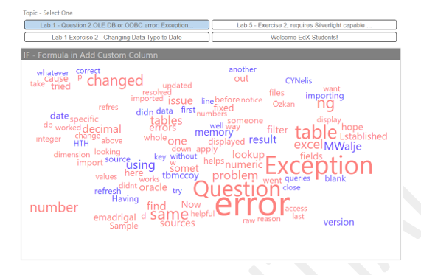
Case Study – Data Science & Analytics
Project
Deliverable
We hired Edward to conduct a Power BI content review and refresh experiment. He assessed a Power BI course in relation to the latest features and current student feedback, and identified any existing gaps.
Feedback to Freelancer
“Edward did a great job and went above and beyond - I look
forward to working with him again.”
Notes:
https://www.upwork.com/jobs/~~eca33bdd8c00e020

Slide 11
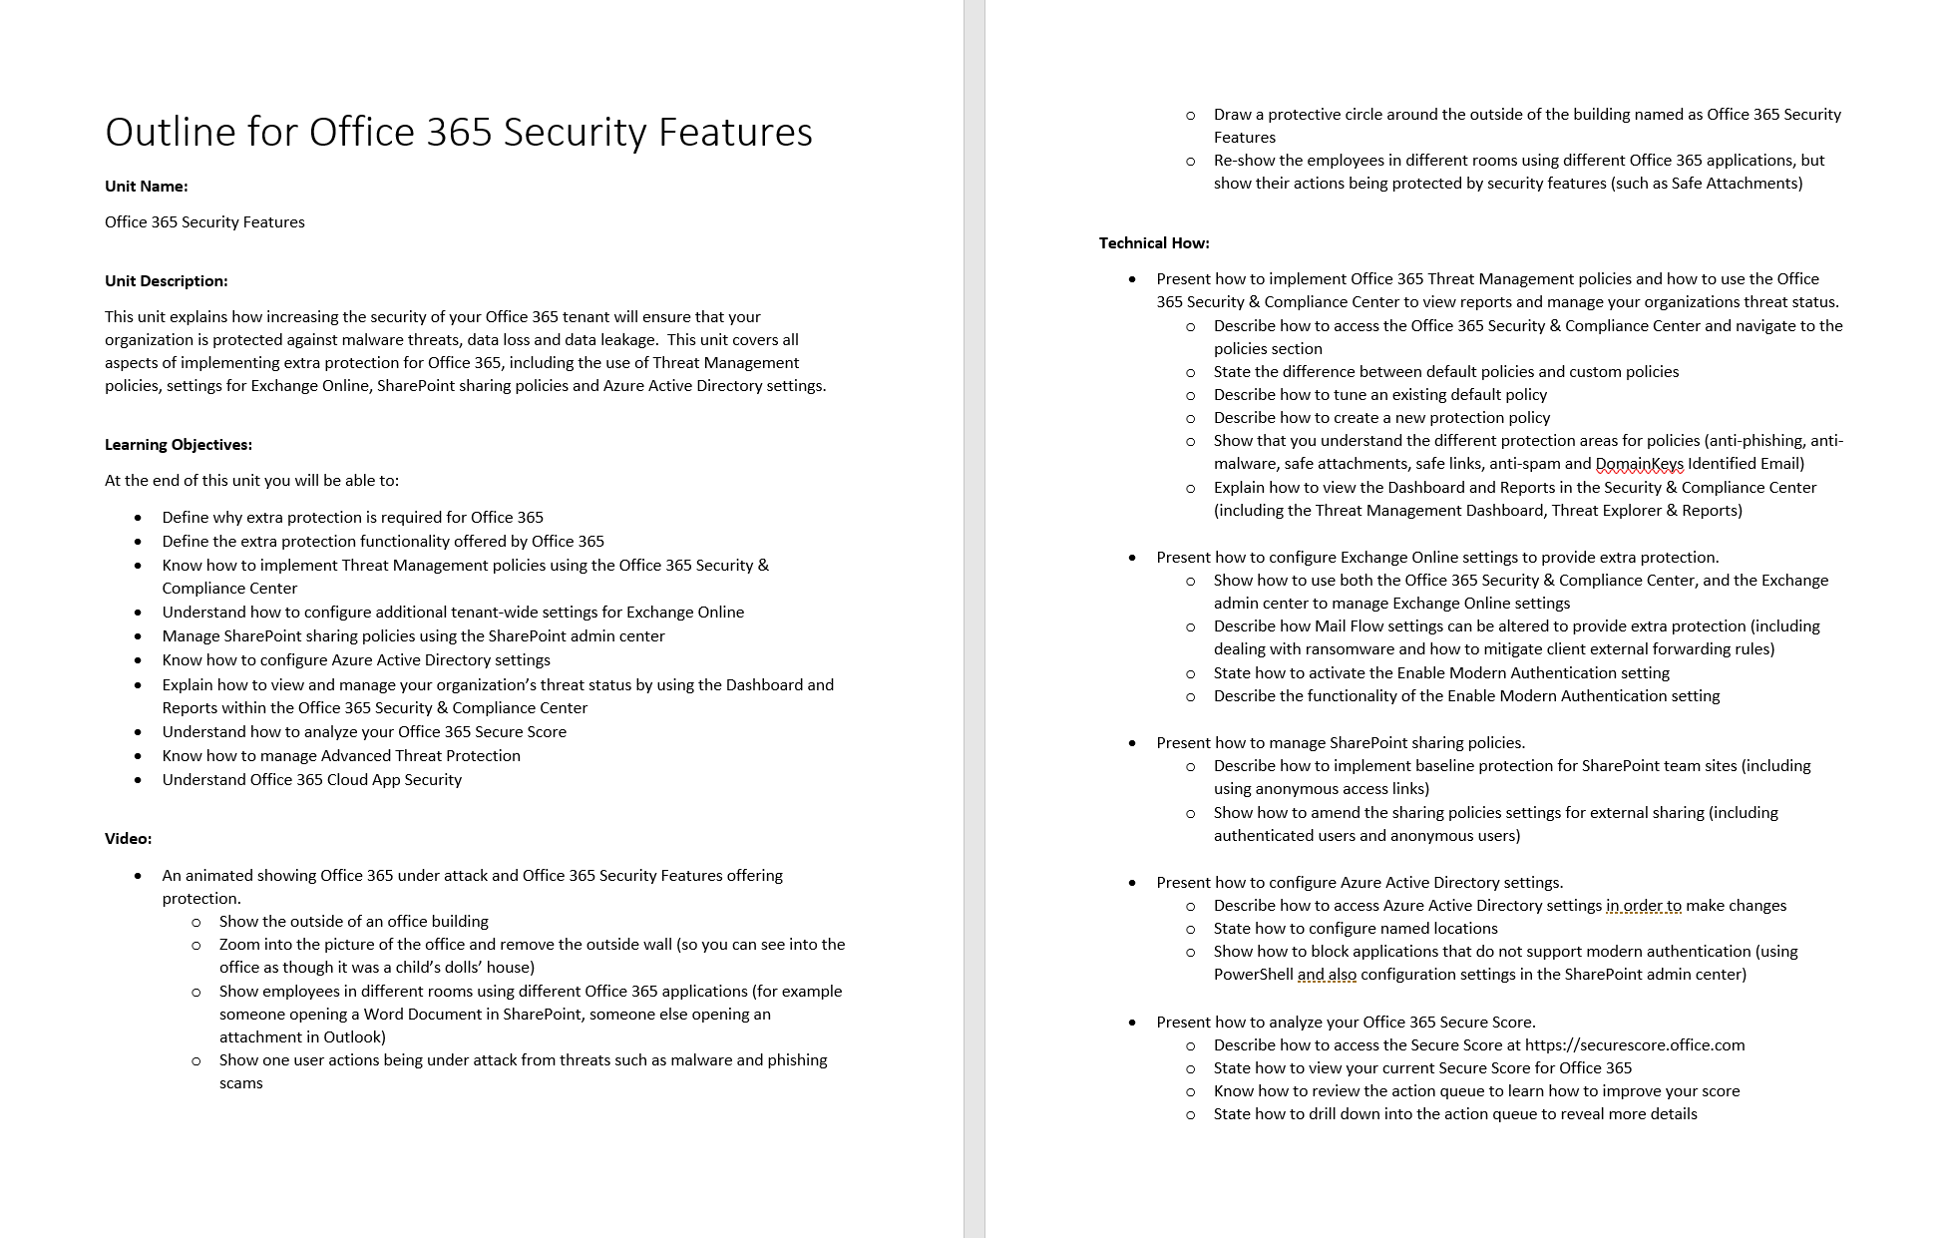
Case Study – Writing
Project
Deliverable
We are producing a series of short form training topics that will be arranged into learning paths. Since the production of each training topic starts with the writing of an outline, we hired a freelancer to produce a written outline that followed a set format and addressed relevant points.
Feedback to Freelancer
“Appreciated the attention to detail.”
Notes:
https://www.upwork.com/jobs/~~eca33bdd8c00e020

Slide 12
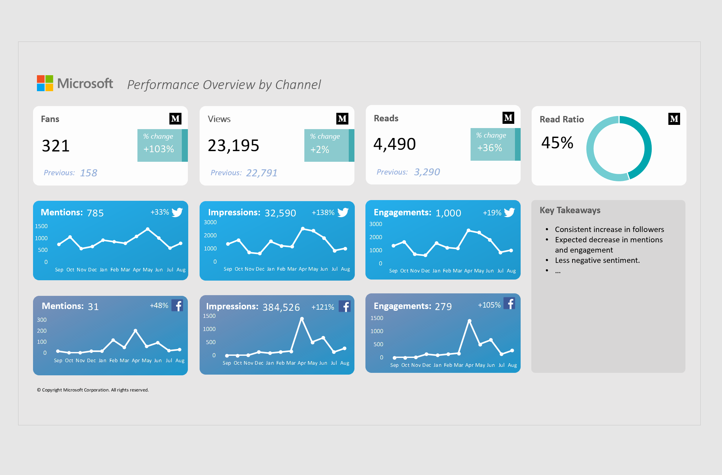
Case Study – Data Science & Analytics
Project
Deliverable
Analyze and interpret data, and turn into easily readable report with actionable insights. Report must be templatized for future use.
Feedback to Freelancer
“Excellent job.”
Notes:
https://www.upwork.com/jobs/~~eca33bdd8c00e020

Slide 13
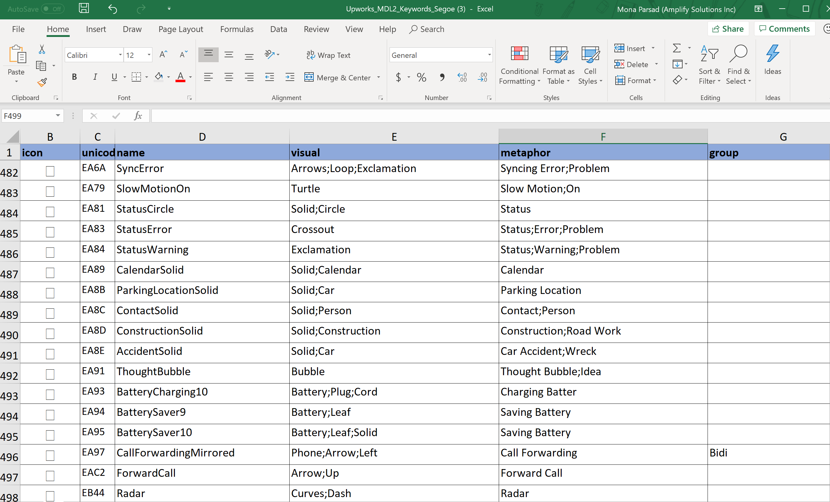
Case Study – Data Science & Analytics
Project
Deliverable
We needed help with keywording a library of icons to help build out our taxonomy for an internal database tool. This involved breaking out the visual (physical), conceptual (metaphor), and category (genre) tags for each icon. Having a solid understanding of metadata, subject classification, and knowledge organization was essential.
Feedback to Freelancer
“Michael was easy to communicate with and asked questions to
clarify what we needed to get the job done right. I appreciated the
follow-ups and would be happy to work with him again.”
Notes:
https://www.upwork.com/jobs/~~eca33bdd8c00e020

Slide 14
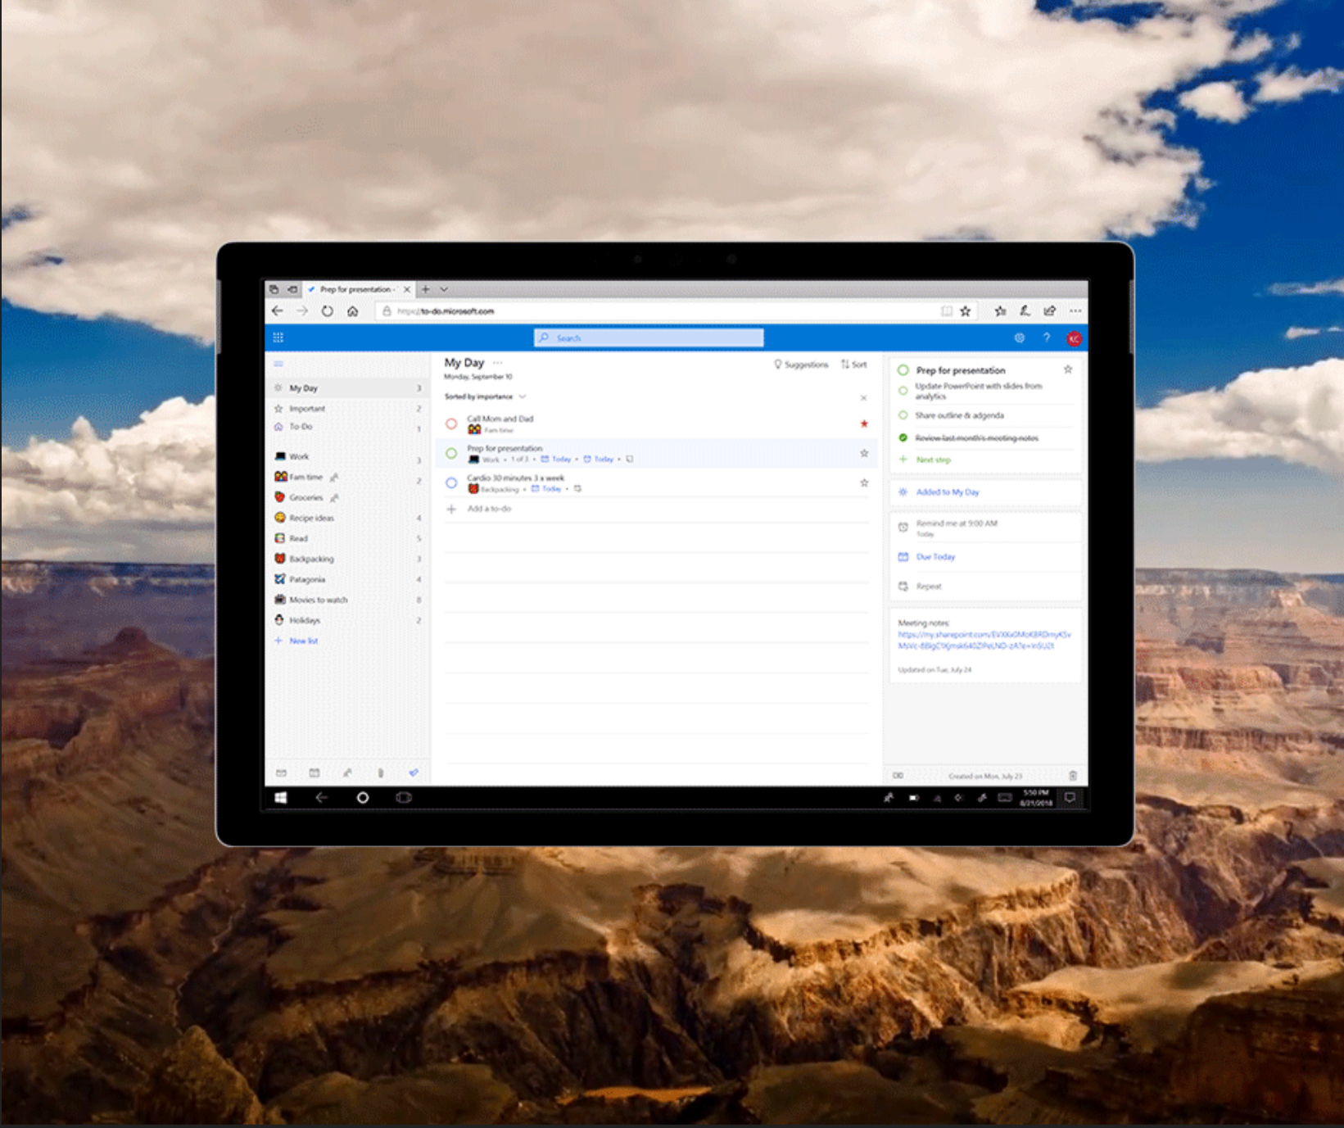
Case Study – Design & Creative
Project
Deliverable
Gif needed for launch of new web app. Background for the asset needed to be a morning scene.
Feedback to Freelancer
“Lyn was super responsive and has a quick turnaround. I will definitely be seeking out her work in the future.”
Notes:
https://www.upwork.com/jobs/~~eca33bdd8c00e020

Slide 15
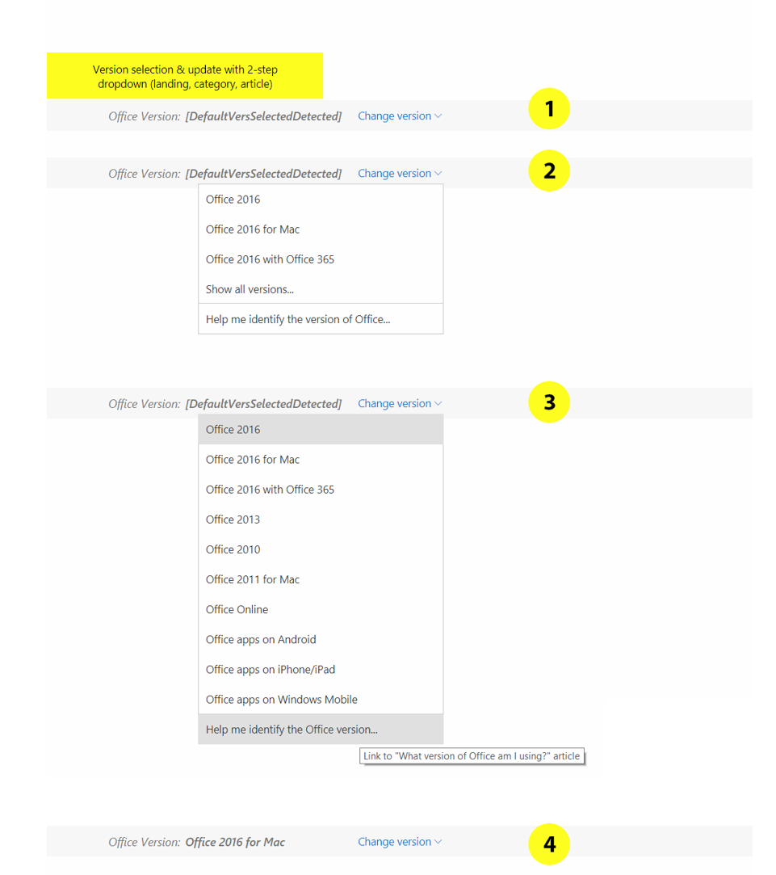
Case Study – Web, Mobile, and Software
Project
Deliverable
Web-based help & how-to content: Design patterns for
navigating help for multiple versions.
Feedback to Freelancer
Daniel was an experienced UX designer who asked great
questions and provided some good options for us.
Notes:
https://www.upwork.com/jobs/~~eca33bdd8c00e020

Slide 16
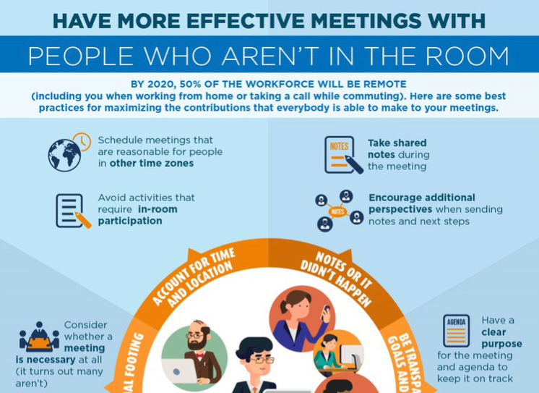

Case Study – Infographic Design
Project
Deliverable
Despite the fact that more and more people are working remotely, meeting habits still tend to focus on a conference room. This leads to a loss of efficiency and poor inclusion of people who aren’t in the room.
After crowd-sourcing some best practices, we hired a freelance designer to create a beautiful infographic to distribute around conference rooms in Redmond.
Feedback to Freelancer
“Super quick turnaround time, willing to accept numerous iterations, high quality work, AND he provided the source .ai files.”
Notes:
https://www.upwork.com/jobs/~~eca33bdd8c00e020

Slide 17
Case Study – Writing
Project
Deliverable
Two articles needed to be edited and proofed for clarity and concision, and needed to be balanced by the MSFT Style Guide and the author's voice.
Feedback to Freelancer
“Jenna was able to accommodate a very quick turnaround time for this last-
minute project.”
Notes:
https://www.upwork.com/jobs/~~eca33bdd8c00e020

